Slide 1
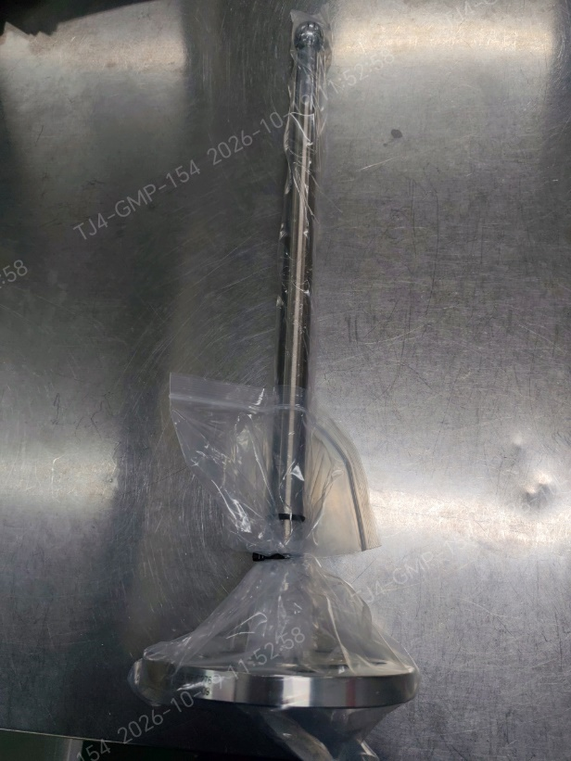
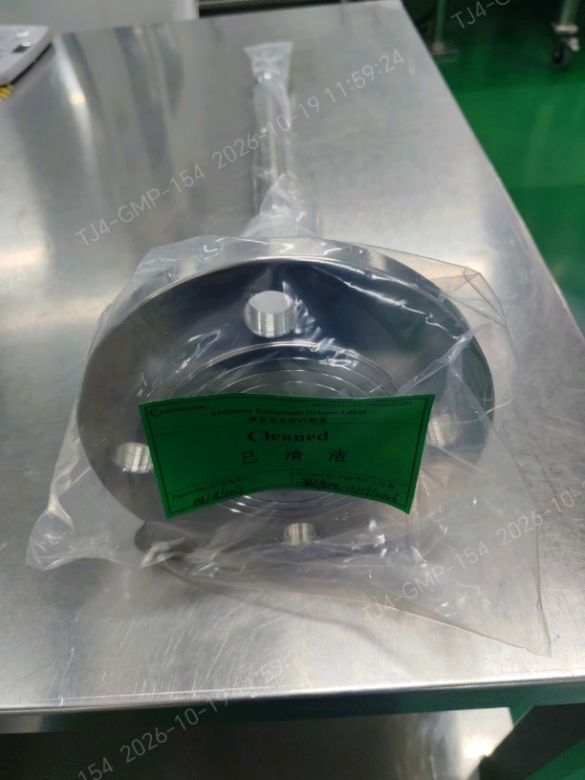
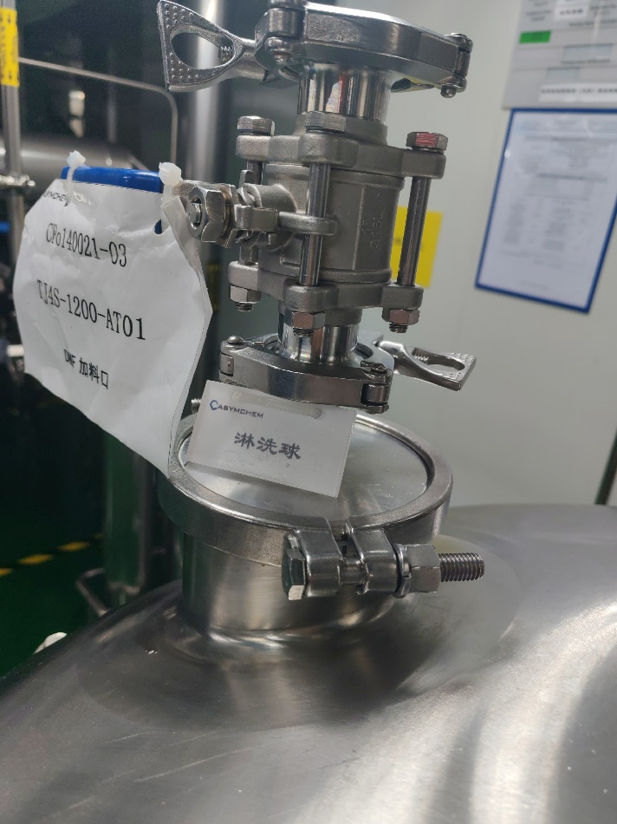
Spray ball installation
1. Spray ball installation + coverage test + riboflavin cleaning + particulate check for AT09/AT01.
ASYM:
1. A stainless steel spray ball was used for the spray coverage test on mixing vessel AT09. Iodine is not compatible with prolonged stainless-steel contact, so this spray ball will be used only as a temporary accessory and will not remain in the vessel.
2. A PTFE spray ball has been purchased for mixing vessel AT09, following Lilly's recommendation and material-compatibility assessment. Given the project timeline, we recommend a trial run and completion of the supplemental spray-coverage verification and cleaning confirmation before this vessel is used for the project.
Proposed completion date: 10/22/2026
3. Mixing vessel AT01 is equipped with a spray ball and has completed spray coverage testing. The missing on-site identification tag has been corrected.
TJ4S-1213-AT09Dedicated spray ball
TJ4S-1200-AT01

Slide 2
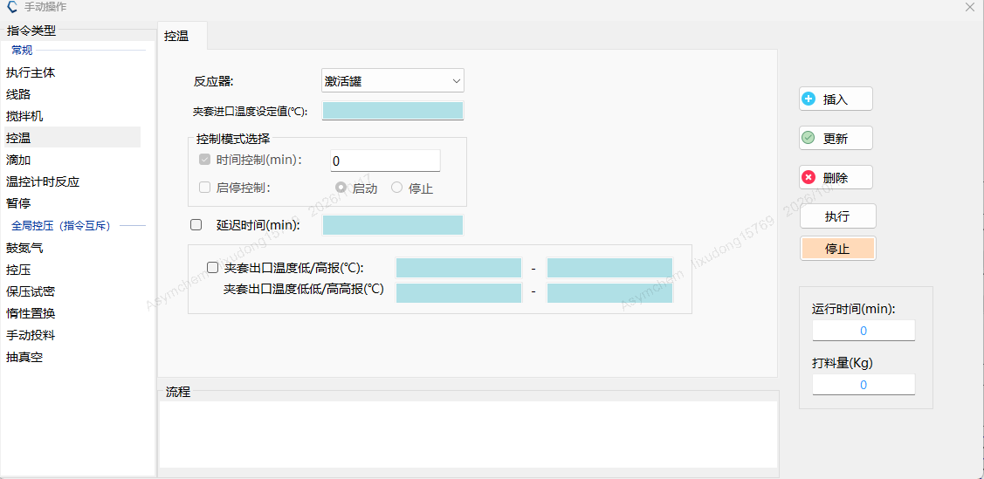
SPPS优化和方案评估
2. Synthesizer SY16 jacket temperature high-high/low-low alarm addition into PLC.
各方案评估：
1、方案1具有高高报/低低报的声光报警功能，有高报/低报预警，触发后人员现场响应，超工艺范围能立即发现；
软件优化
2、方案2和3
a、仅有高报/低报的声光报警，管理上要求设置为预警值，触发报警后人员现场响应，超工艺范围需OR与电子数据核对；
b、MOR中已有要求每个操作需要输出温度极值，超出工艺范围未被发现的风险较低；
3、方案2与方案3差异是配碘溶液搅拌罐淋洗覆盖率测试时间不同，搅拌罐使用时间为投料后~7d，淋洗覆盖率验证和清洗需要~2d，设备验证相对独立不影响合成仪使用，因此方案3整体影响较小；
验证方案及投料时间计划与评估
方案 | 20 | 21 | 22 | 23 | 24 | 25 | 26
方案1 | 软件升级 | 验证 |  | 碘氧化试车 |  | CMa | 投料
方案2 | 淋洗覆盖率测试 | 碘氧化试车 |  | CMa | 投料
方案3 | 碘氧化试车 |  | CMa | 投料 | 淋洗覆盖率测试 | 搅拌罐清洁
综上，基于投料时间，我们建议方案3

Slide 3
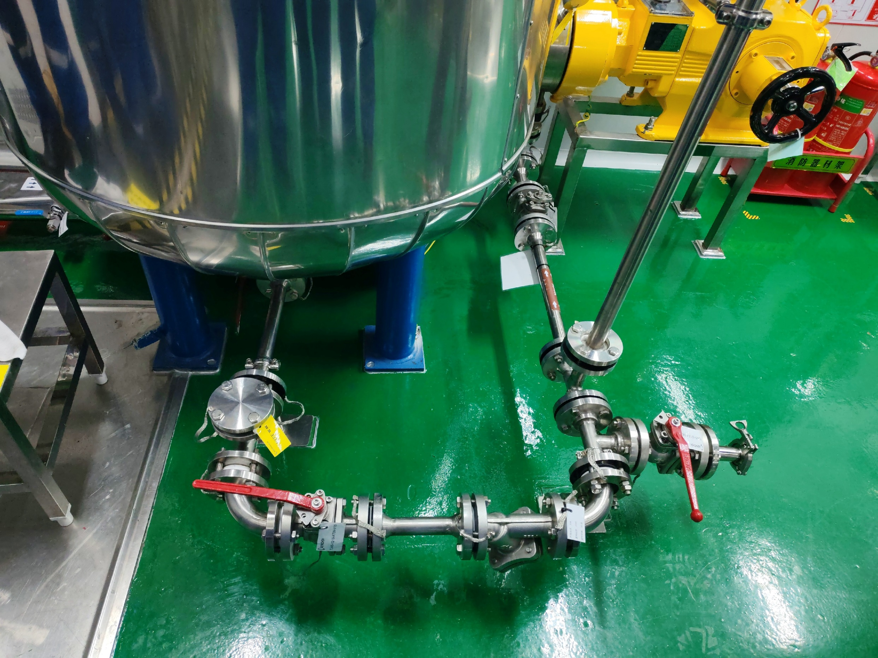
管路整改
3. Unused side loop dead legs removal from iodine solution transfer pipeline.
ASYM: Completed. 多余的阀门已经拆除，增加了PTFE的盲板并悬挂标识。

Slide 4
4. Iodine solution nitrogen transfer time qualification before solvent run.
ASYM: Nitrogen transfer of the iodine solution to the synthesizer will be performed during the solvent run.
Proposed completion date: 10/22/2026

Slide 5
5. Post oxidation DMF cooling time qualification by activation tank in solvent run.
ASYM：The post-oxidation DMF cooling-time test in the activation tank will be performed during the solvent run.
Proposed completion date: 10/22/2026

Slide 6
6. Pre-production equipment train rinse/swab cleanness acceptance or equivalent as stated in contamination control strategy.
ASYM：
1. 设备链钝化结束后的清洗已经完成， TOC 检测也已完成；
2. 溶剂试车中用到了单质碘，试车结束以后会对设备链进行清洗，并使用试纸确认碘残留；

Slide 7
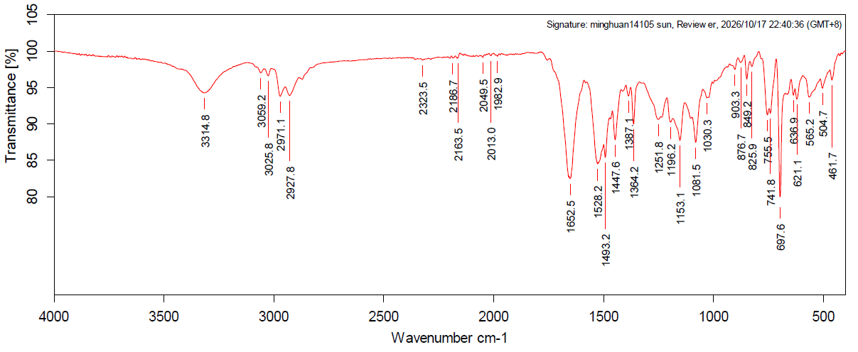
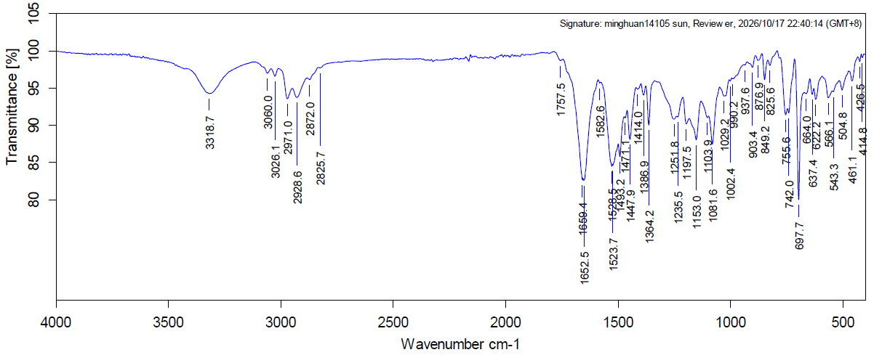
7. Investigation on contaminated sampling tool in the glovebox of L3 synthesizer SY16 and yellow solid contamination in the glovebox of L2 synthesizer SY15. Confirmation of contaminant ID is high recommended or at minimum the contamination must be confirmed to be limited to glovebox only, i.e., the possibility of contamination in the synthesizer must be ruled out.
ASYM：
1. Sy15合成仪最近一次进行了140020 step1的固相合成，对Sy15合成仪手套箱中的黄色固体进行了收集，并进行红外鉴定，合成仪内部检查没有物料残留，被测样品红外出峰与140020的肽树脂出峰相符；
对照品
Sy15合成仪手套箱中黄色固体

Slide 8
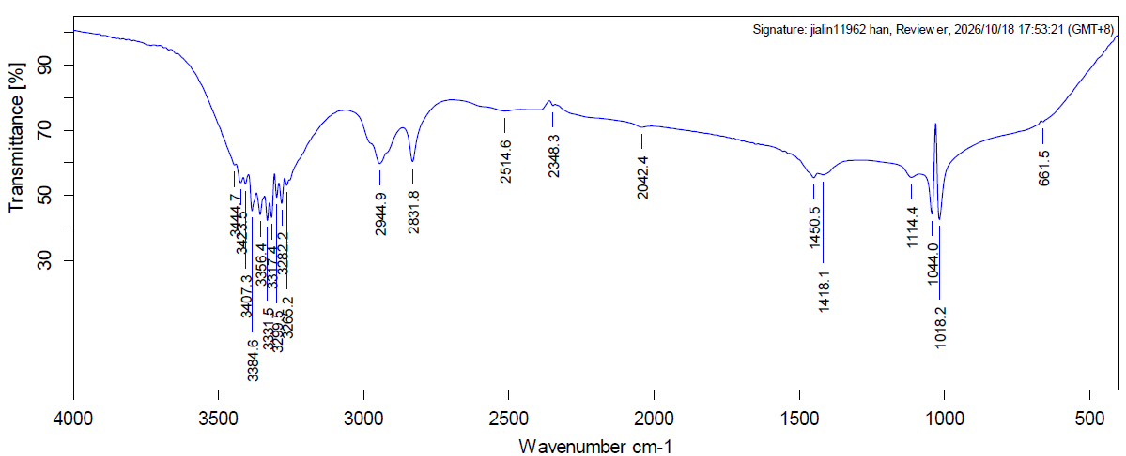
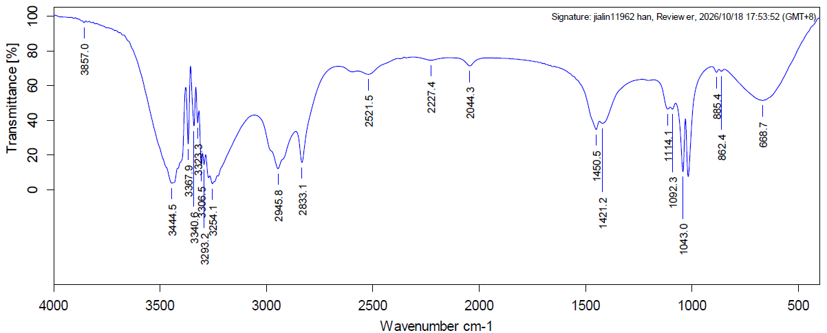
7. Investigation on contaminated sampling tool in the glovebox of L3 synthesizer SY16 and yellow solid contamination in the glovebox of L2 synthesizer SY15. Confirmation of contaminant ID is high recommended or at minimum the contamination must be confirmed to be limited to glovebox only, i.e., the possibility of contamination in the synthesizer must be ruled out.
ASYM：
2. Sy16合成仪手套箱中取样器外包装袋子占有污染物的部分进行取样进行红外鉴定，选定的对照品为设备使用过且挥发度低的物质DMF，乙二醇， 合成仪内部检查没有物料残留，从红外谱图看LDPE袋子污染物与乙二醇图谱特征峰相符；
Sy16合成仪手套箱中LDPE污染物
乙二醇

